Slide 1
WORSHIP
Focus on God.
Listen to your teachers (cos they are helping you to focus).
Be sincere.
Colossians 3:23
“Whatever you do, work at it wholeheartedly as though you were doing it for the Lord and not merely for people.”

Slide 2
SONGS THAT DECLARE THE GOSPEL
https://www.youtube.com/watch?v=LULK2nZ6sCc&ab_channel=SovereignGraceMusic
3rd verse:
Behold Him there, the risen Lamb My perfect, spotless Righteousness The great unchangeable I AM The King of glory and of grace One with Himself, I cannot die My soul is purchased by His blood My life is hid with Christ on high With Christ my Savior and my God

Slide 3
WHY WAS ISRAEL SO REBELLIOUS?

Slide 4
OBJECTIVES
Prepare hearts for gospel message next week
Where are they? Have seen Israel rebelling over and over again. Moses too. God forgives.
Where do we want them to be? Move from seeing Israel’s sin to seeing my own sin.
Journey:
Dot plot of sin/good? Reveals whether they think that humans are good at the core.
What about Israelites? Were they good at the core? No, because every situation shows what is inside them. They didn’t become sinners because they sinned. They sinned because they were sinners. Even Moses when he was squeezed at the end, sinned.
Want them to see that what oozes out is what was inside. When you squeeze it you see. A sponge! “From the overflow of the heart the mouth speaks”. Also advice for life, if you really want to know what is in a person’s heart, you must watch people’s lives not their mouths. In hardship it all comes out.
Your own life. What happens when you are squeezed? When a friend wrongs you – revenge. When you don’t get what you want – you yell and get angry. When you’re hungry – who do you scold? When your free time is stolen by responsibility – do you just do the bare minimum?
What does this all tell you about your heart?
After seeing Israel and ourselves, do you want to revise your dot?
Contrast to Jesus – when he was reviled, he did not curse. He prayed for those who crucified him. He loved those who betrayed him. He could have called down Legions. He became poor that we might become rich.
When you see Jesus, you see how rotten you are to the core. Sinner through and through. If you don’t see your sin, pray on your knees and beg God to let you see your sin as evil. Because until you recognise you are a sinner and until you hate your sin, you are not fit for the Promised Land. Until you hate your sin, you will never really want Jesus as your Savior. So pray and ask God because your soul depends on it.

Slide 5
RECAP

Slide 6
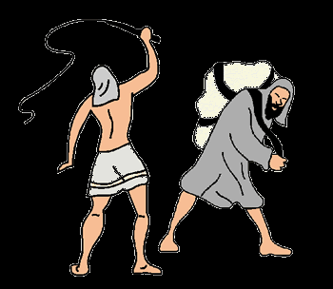
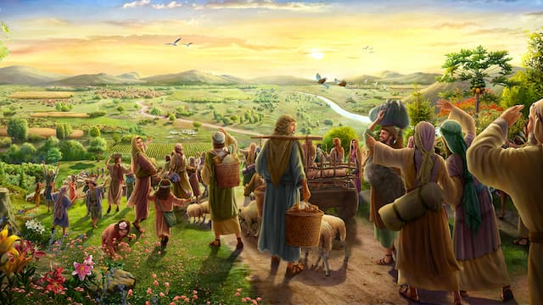
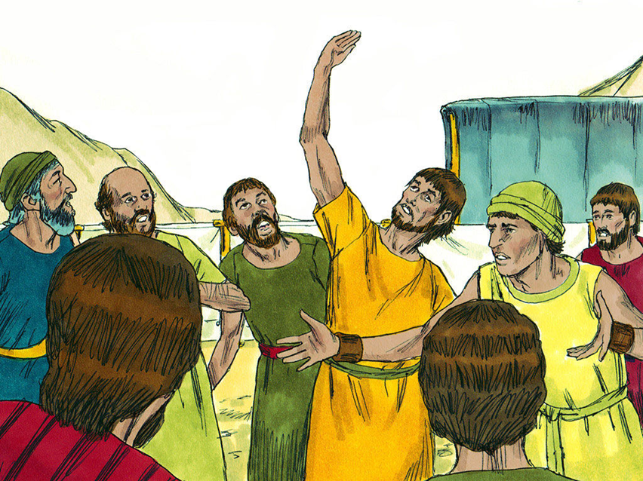
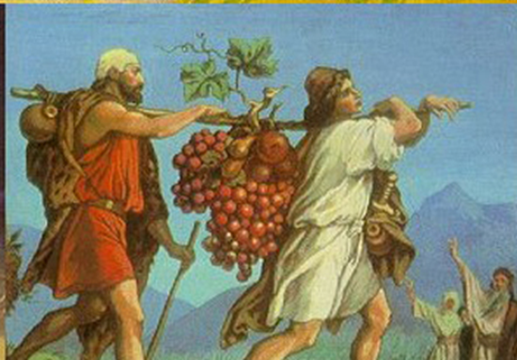
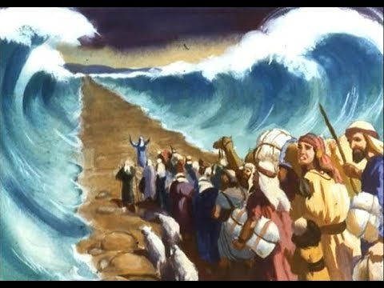
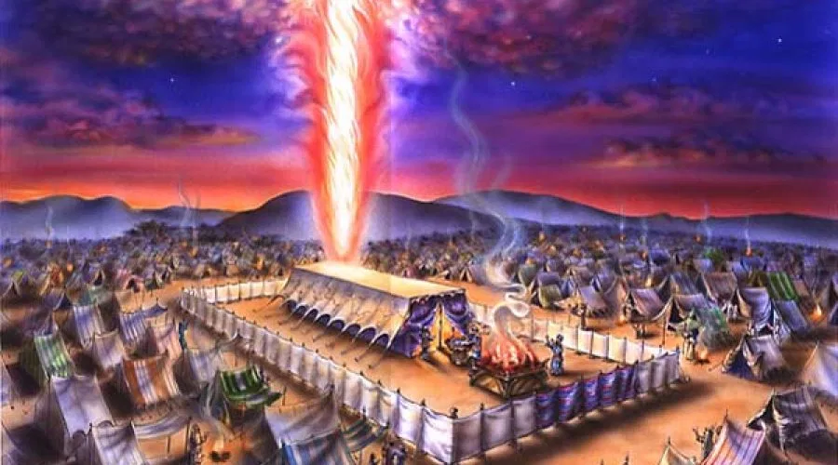
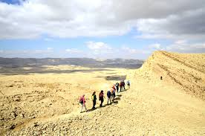
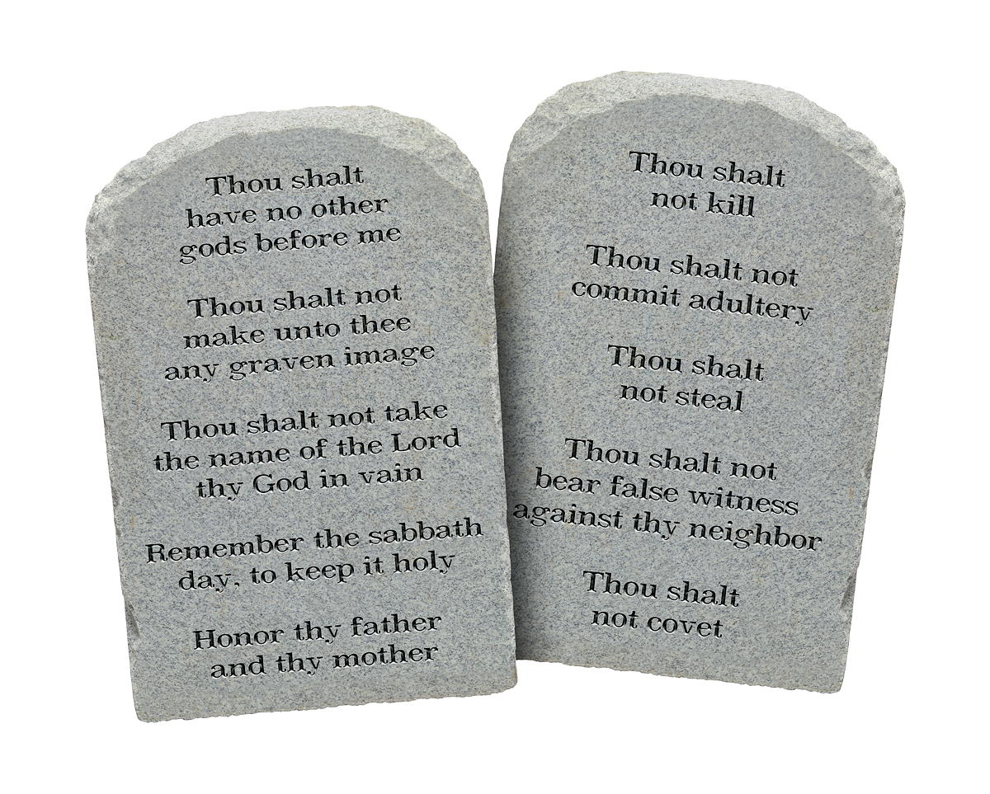
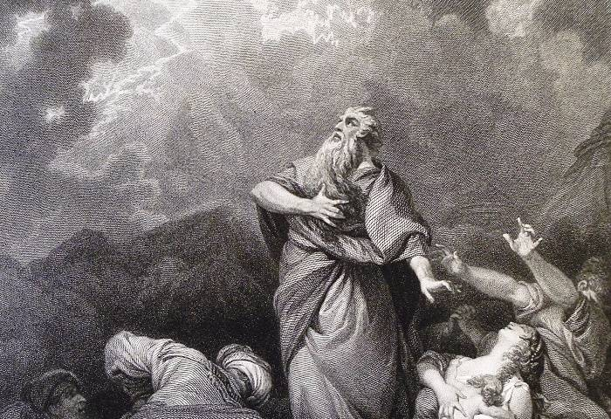
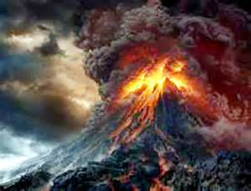
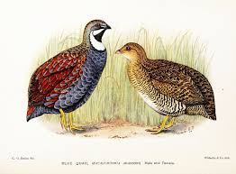
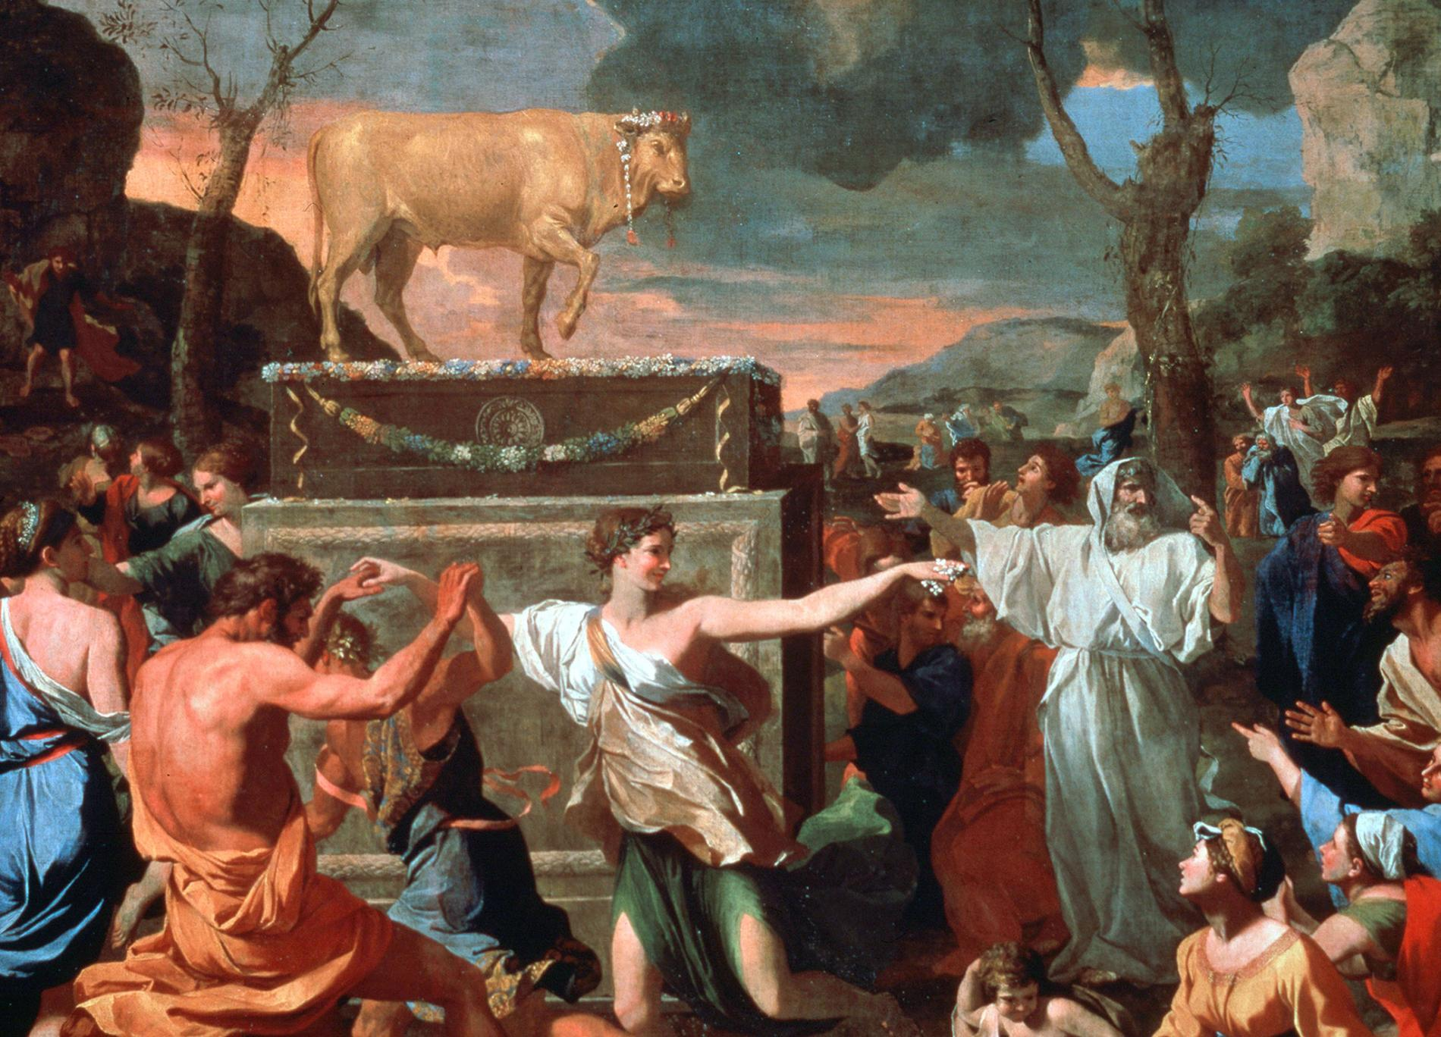
“EXODUS”
40 years punishment

Slide 7
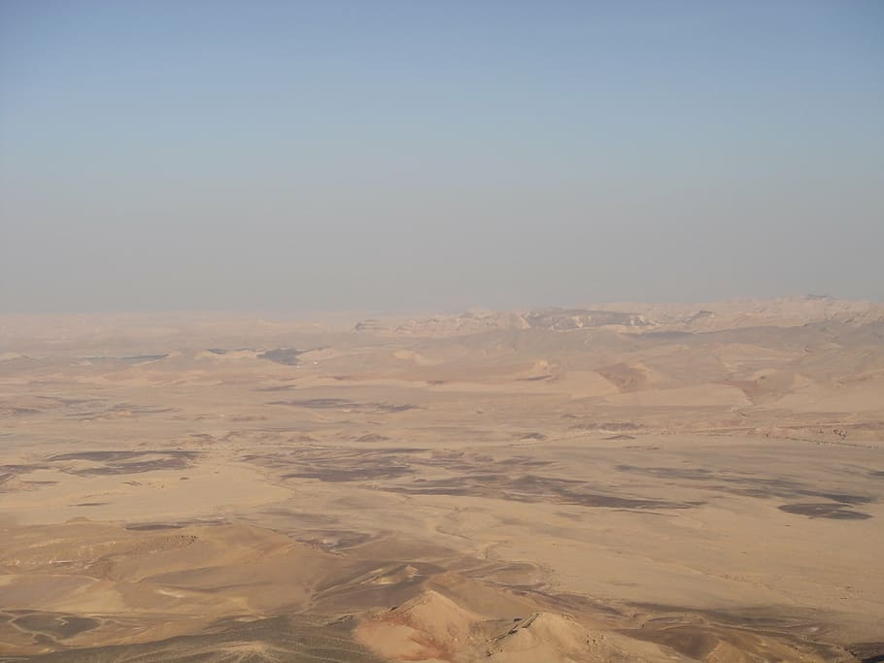

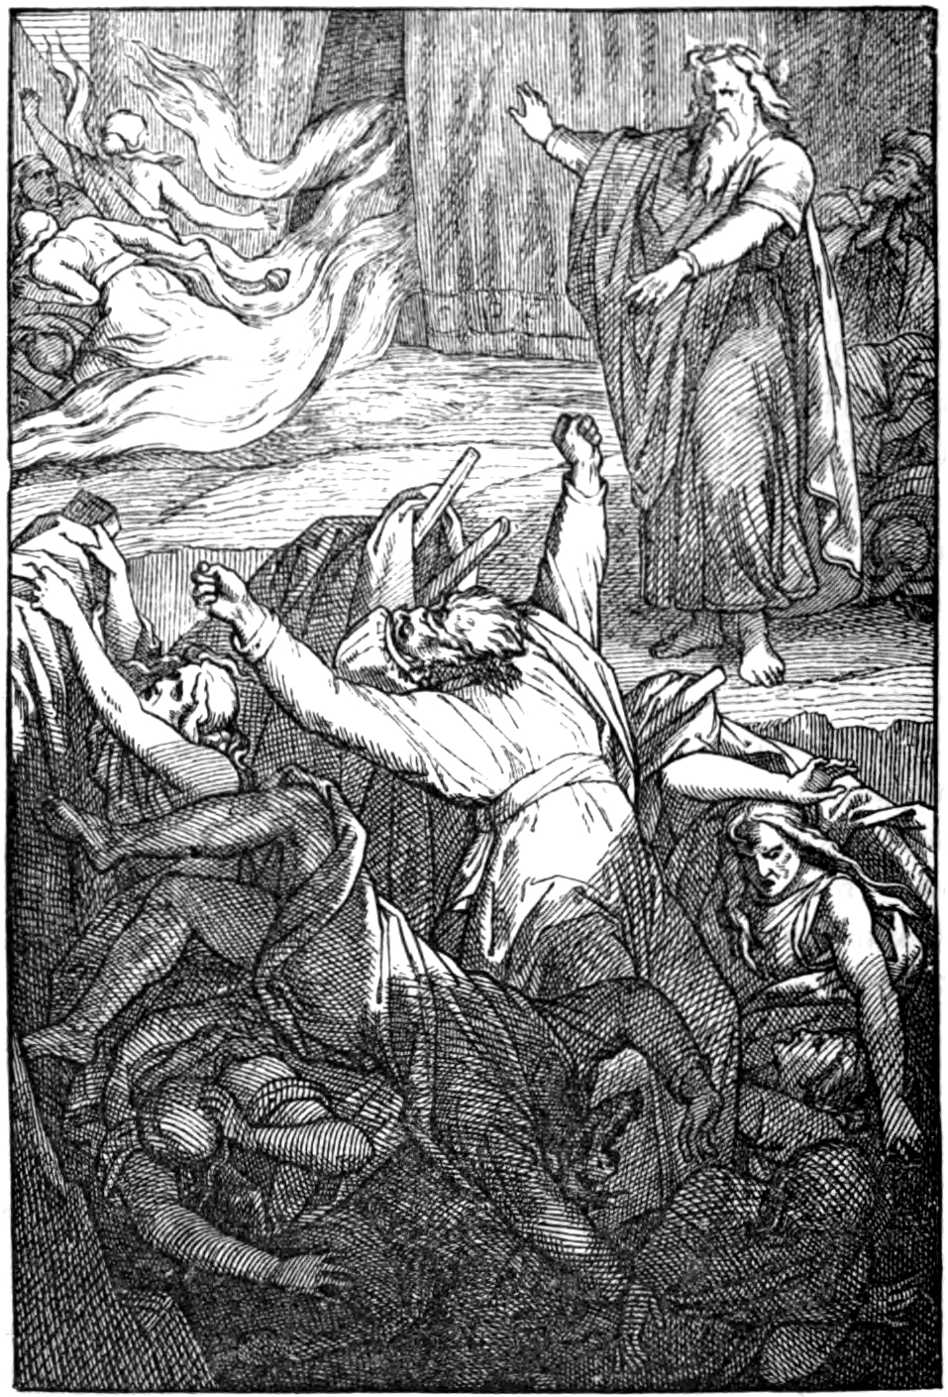
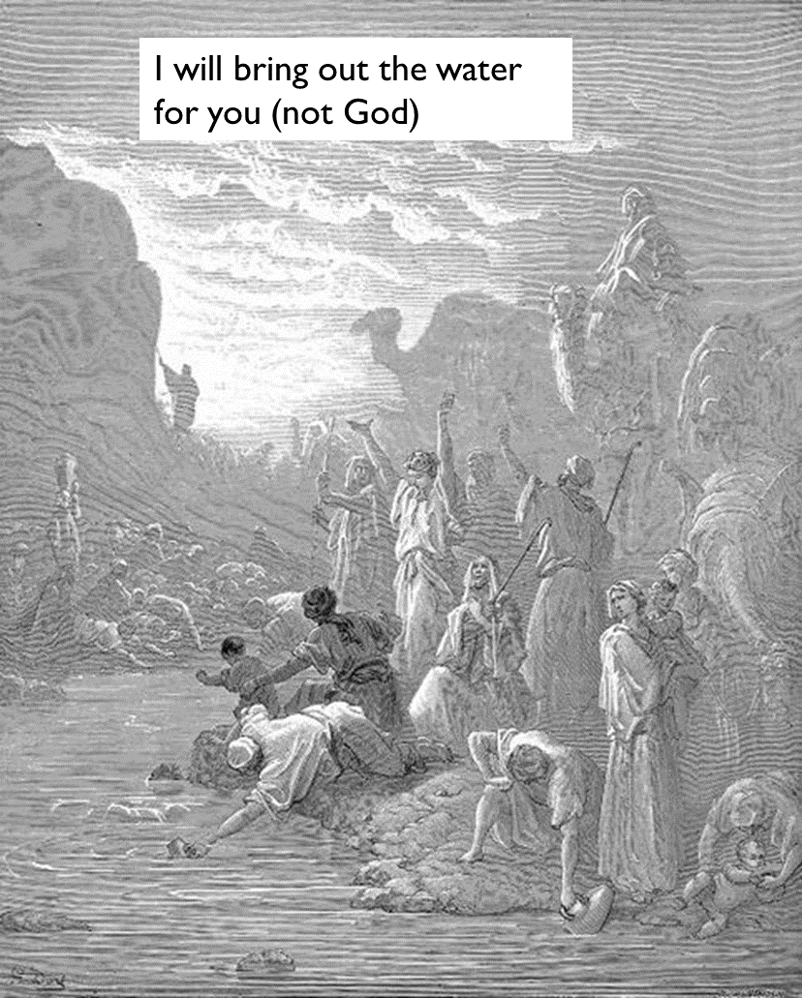
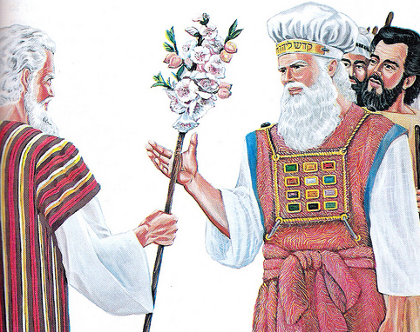
The Promised Land
“NUMBERS”
The Desert
40 years punishment
In the desert
New generation approach the Promised Land
Adults all died for their sin

Slide 8
THE END OF THE EXODUS
Garden of Eden
Moses & Promised Land
King David
God is good and loves humans
Humans are evil and keep rebelling against God and get they into trouble
God’s chosen human rescuer helps them on the outside
But he/she fails to change the heart
So the humans keep sinning
Who is God’s saviour who can change our hearts?
Slavery in Egypt
Rest of Old Testament

Slide 9
IS THE CORE OF OUR HEART GOOD OR EVIL?

Slide 10
HOW DO YOU KNOW IF SOMEONE IS REALLY A FRIEND?
REAL FRIEND
PRETEND FRIEND

Slide 11
HOW DO YOU KNOW IF SOMEONE IS REALLY A FRIEND?
REAL FRIEND
PRETEND FRIEND
Keeps your secrets safe
Will sacrifice to help you
Defends you when you’re not around
Feels warm and fuzzy when they think of you
Betrays your trust
Refuses to help you when you’re in need
Says nasty things about you
Has no real feeling about you

Slide 12

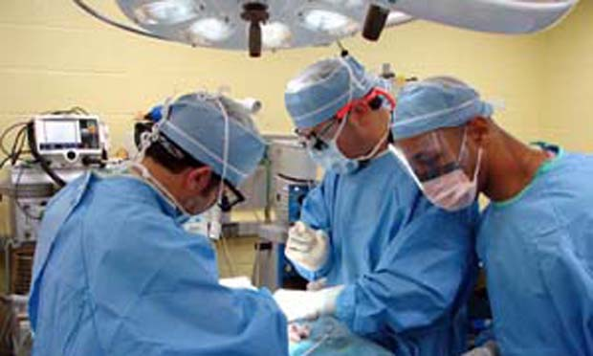
HOW CAN YOU TELL EVEN IF YOU CANNOT SEE WHAT IS ON THE INSIDE?

Slide 13
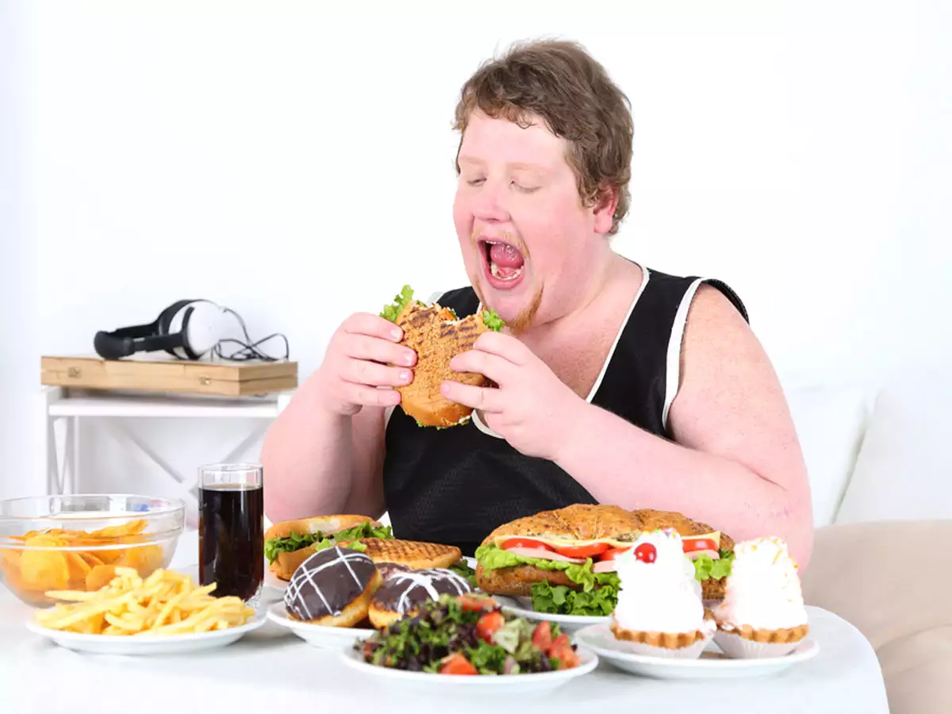

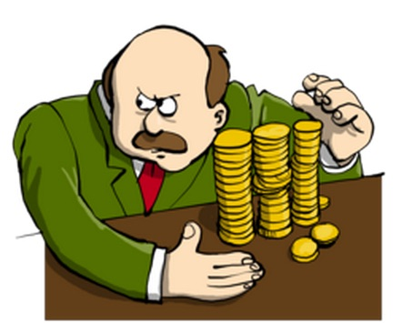


HOW DO WE KNOW WHAT IS INSIDE A PERSON’S HEART?

Slide 14
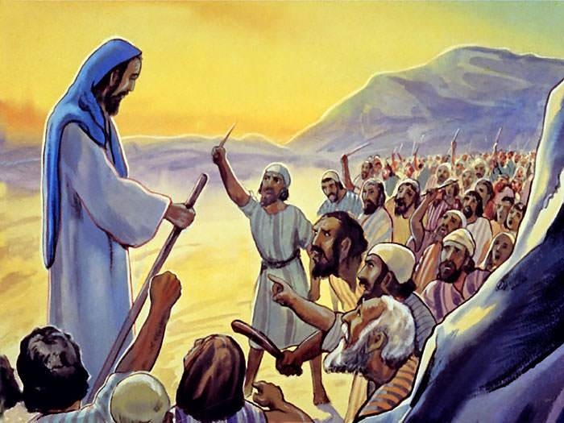
WHAT WAS IN ISRAEL’S HEART?
The first chance they get, they made and worshipped a golden calf, disobeying God’s first commandment
Refused God’s good leader and wanted their own selfish leaders
Thought that God wanted to abandon and betray them every time they got hungry or thirsty
Doubted that the same God who parted the Red Sea could help them defeat their enemies
Notes:
Use whiteboard

Slide 15
“God led you 40 years in the desert…testing you to show what was in your heart, whether you would keep his law or not” – Moses warning Israel in Deuteronomy Chapter 8

Slide 16




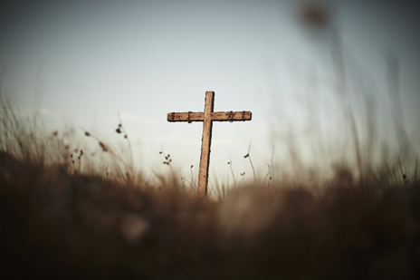
WHAT IS IN YOUR HEART?
When someone wrongs you…REVENGE
Do you serve others or only think of yourself?
Chasing success at the expense of following Jesus Christ with your life?
Do you love God with all your heart?

Slide 17
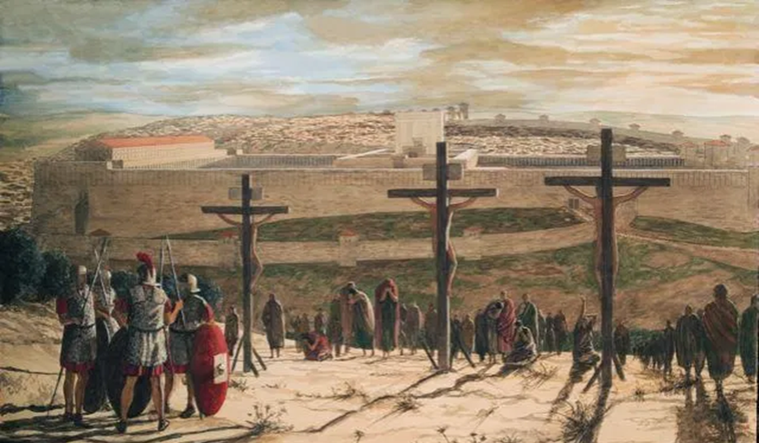
WHAT IS IN JESUS’ HEART?
What did Jesus do:
When he was mocked on the cross?
When his friends abandoned him?
As he was being murdered on a Roman crucifix?
When he had to choose to die by the cross or to have a comfortable life?
Notes:
He kept quiet and did not protest
He forgave them
He prayed for his killers

Slide 18
GAME

Slide 19
DO YOU WANT TO REVISE YOUR DOTS?

Slide 20
WHAT DOES THE BIBLE SAY?
“All have sinned and fall short of the glory of God” – Romans 3:23
“None is righteous, no, not one; no one understands; no one seeks for God. All have turned aside; together they have become worthless; no one does good, not even one.” – Romans 3:11-12
“Whoever keeps the whole law and yet stumbles at just one point is guilty of breaking all of it.” – James 2:10

Slide 21
HOW DO WE DEAL WITH OUR SIN?
Conviction (hate your sin)
Confess (admit you cannot fix yourself)
Repent (decide to obey Jesus forever)
Believe (it was finished by Jesus)
Notes:
Ask them for instructions. Ask those who have made the decision, to share.

Slide 22
WHAT IF I DON’T REALLY FEEL CONVICTED?
First, don’t pretend like you are convicted – God sees your true heart.
Pray and beg God to reveal your sin to you!
If you’ve never felt the weight of your sin and how holy God is, you won’t see Jesus as a wonderful Saviour.
Only God can convict your heart, so ask him!

Slide 23
And this is the confidence that we have toward him, that if we ask anything according to his will he hears us. ~ 1 John 5:14

Slide 24


Yahweh is Holy
YHWH
If we could remove our sin…
We could approach God!
LOVE | BEAUTY | JOY | KINDNESS | JUSTICE | MEANING | FULL LIFE ...
Purified humans
Sinful humans
Notes:
Get hands to indicate where are you right now? The unpurified one or the purified one?

Slide 25
HOW DO I DEAL WITH MY SIN?
“we know that a person is not justified by works of the law but through faith in Jesus Christ…because by works of the law no one will be justified.” – Gal 2:16
Guilt = realising that you have broken God’s law and how sinful your heart is.
Conviction = hating your sin and realising that Jesus is
Repentance = turning 180 degrees away from sin and deciding to serve God for the rest of your life
Salvation = no longer looking to your religion to save you but looking to Jesus’ death and resurrection
When you see Jesus, you see how rotten you are to the core. Sinner through and through.
If you don’t see your sin, pray on your knees and beg God to let you see your sin as evil.
Because until you recognise you are a sinner and until you hate your sin, you are not fit for the Promised Land.
Until you hate your sin, you will never really want Jesus as your Saviour.
Pray and ask God because your soul depends on it.

Slide 26
for all have sinned and fall short of the glory of God, and are declared righteous by his grace as a gift, through the redemption that is in Christ Jesus ~ Romans 3:23-24

Slide 27
TIME OF REFLECTION SONG
https://www.youtube.com/watch?v=PZZQ3qTaivE&ab_channel=JesusChristismyLord

